Slide 1
Spring Boot CRUD Example

Slide 2
Spring Boot CRUD Example
This ppt will help to build a simple Faculty Management System web application using Spring Boot, Spring MVC, Thymeleaf, Spring Data JPA, and MySQL database.
We will build a CRUD operations for the Faculty entity in our Faculty Management System web application

Slide 3
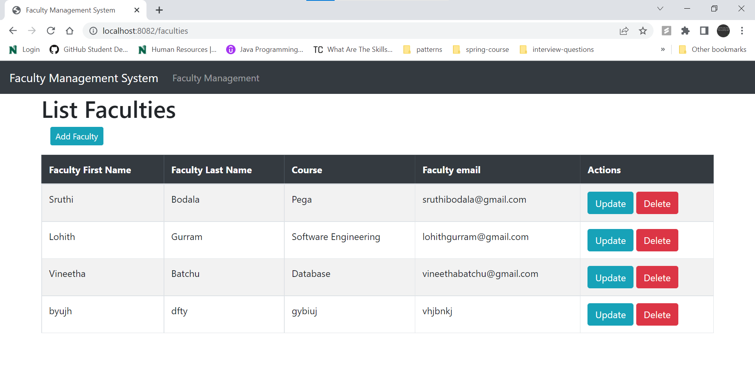
Faculty Management System
This Web Application will look as Above

Slide 4
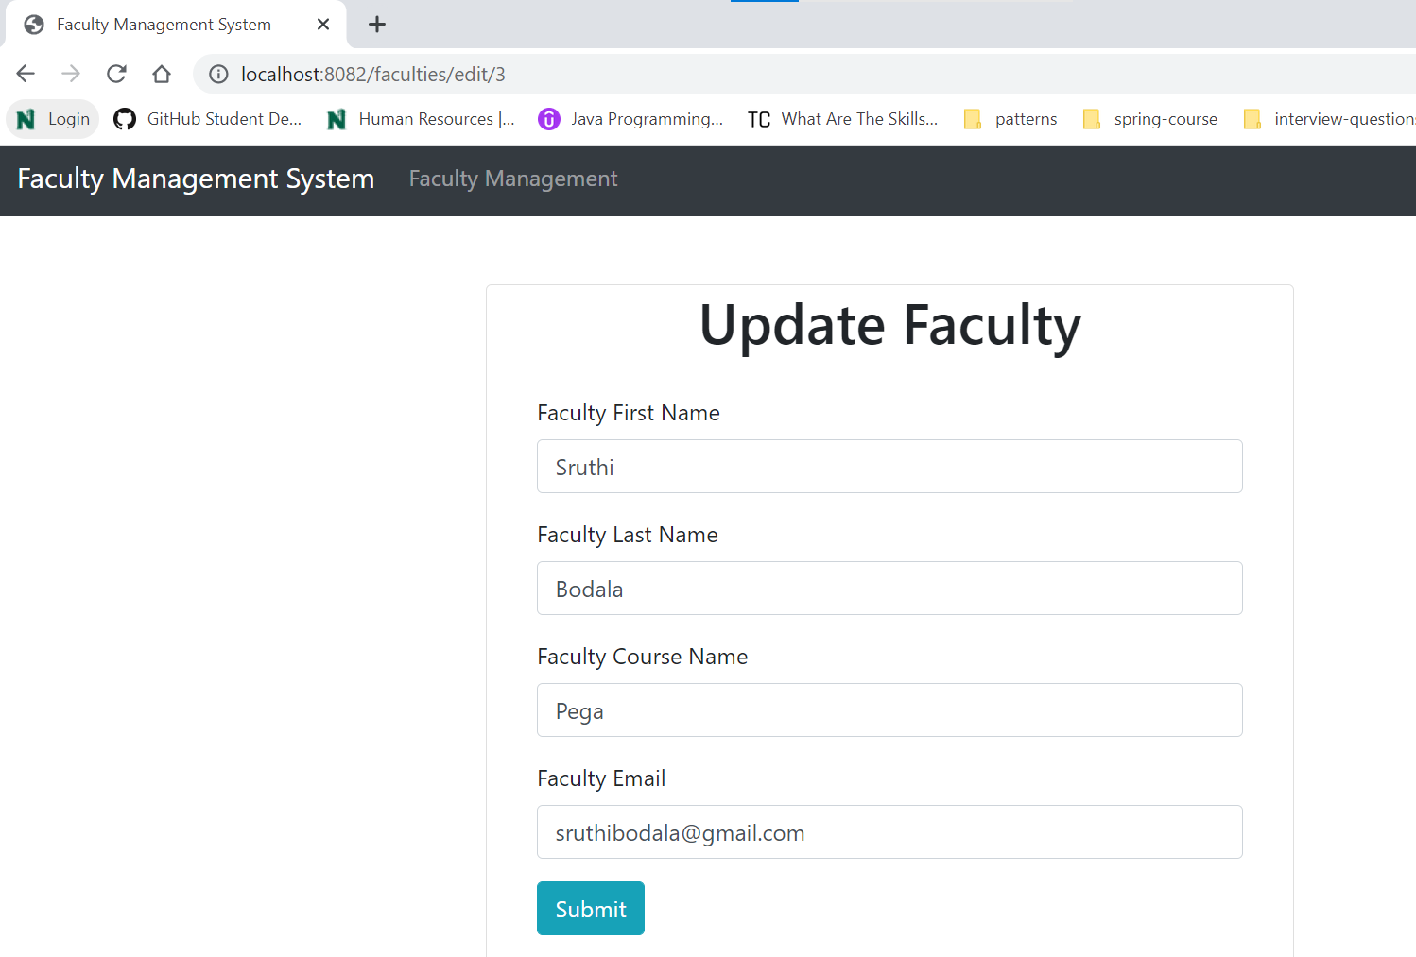
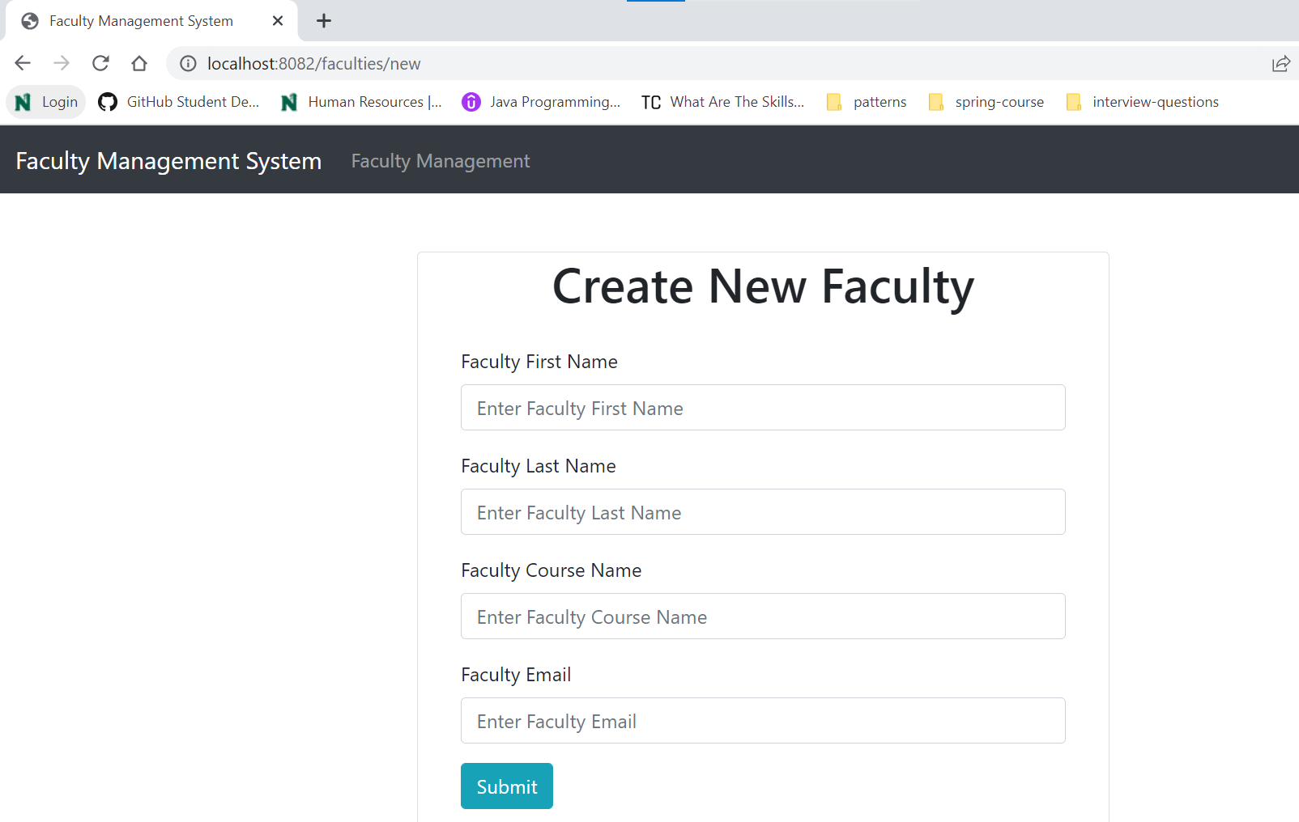
Faculty Management System
Update Page
CreatePage

Slide 5
Tools and Technologies Used
Java 16
Spring Boot
Spring MVC
Spring Data JPA ( Hibernate)
MySQL
Thymeleaf
Eclipse STS

Slide 6
Faculty Management System
1.Create Spring Boot Project
Use the below guide to create a Spring boot project in Eclipse STS IDE:
Selected below dependencies while creating spring boot project using spring initializer:
Spring Web
Thymeleaf
Spring Data JPA
MySQL Driver
Spring Boot Devtools

Slide 7
Faculty Management System
2. Create Spring Boot Project Structure
Let's create the below packages in our Spring boot project:
controller
service
repository
entity

Slide 8
Faculty Management System
3. Add Maven Dependencies
After creating the spring boot project, verify your pom.xml with the below pom.xml file:
(Click on the below icon to download the pom.xml file and compare)

Slide 9
Faculty Management System
4. Create Faculty JPA Entity
Let's create a Faculty JPA entity under the entity package and add the following content to it:
(Click on the below icon to download the faculty.java file )

Slide 10
Faculty Entity
@Entity - This annotation specifies that the class is an entity. This annotation can be applied to Class, Interface of Enums.
@Table - JPA annotation specifies the table in the database with which this entity is mapped.
@Id - The @Id JPA annotation specifies the primary key of the entity.
@Column - The @Column annotation is used to specify the mapping between a basic entity attribute and the database table column.
@GeneratedValue(strategy=GenerationType.IDENTITY) is used to assign a Unique Id automatically

Slide 11
Faculty Management System
5. Create JPA FacultyRepository
Let's create a FacultyRepository interface under the repository package and add the following content:
JpaRepository is a JPA (Java Persistence API) specific extension of Repository.
It contains the full API of CrudRepository and PagingAndSortingRepository.
So, it contains API for basic CRUD operations and API for pagination and sorting.

Slide 12
Faculty Management System
6. Configure MySQL Database
Before configuring the MySQL database configuration in our Spring boot project, first, create a database named FMS in MySQL workbench:
create database fms

Slide 13
Faculty management System
Let's open the application.properties file and add following content to it:
If the port is occupied, it can be changed by changing the number in ‘server.port=8082‘

Slide 14
Faculty Management System
7. Creating Service Layer
FacultyService Interface
Let's create a FacultyService interface under the service package and add the following content to it:

Slide 15
Faculty Management System
FacultyServiceImpl Class
Let's create a new package called impl inside the service package. Let's create FacultyServiceImpl class and add the following content to it:

Slide 16
Faculty Management System
8. Controller Layer
Let's create a FacultyController class and add the following content to it:

Slide 17
Faculty Management System
9. View Layer
resources/templates/faculties.html
Let's create a faculties.html file and add the following content to it:
We have used th:each Thymeleaf attribute in our template to iterate the list of faculties:

Slide 18
Faculty Management System
resources/templates/create_ faculty.html
Let's create a create_faculty.html file and add the following content to it:

Slide 19
Faculty Management System
resources/templates/edit_faculty.html
Let's create an edit_ faculty.html file and add the following content to it:

Slide 20
Faculty Management System
10. Run Spring Boot Application
Run the Spring boot application with the main class:

Slide 21
Faculty Management System
11. Demo
Once the Spring boot application is up and running then use the below URL to access this application:
URL: http://localhost:8082/faculties
Reference for this Project:
https://github.com/vineetha-batchu/faculty-management-system

Slide 22
Spring Boot CRUD Example
The End

